Slide 1
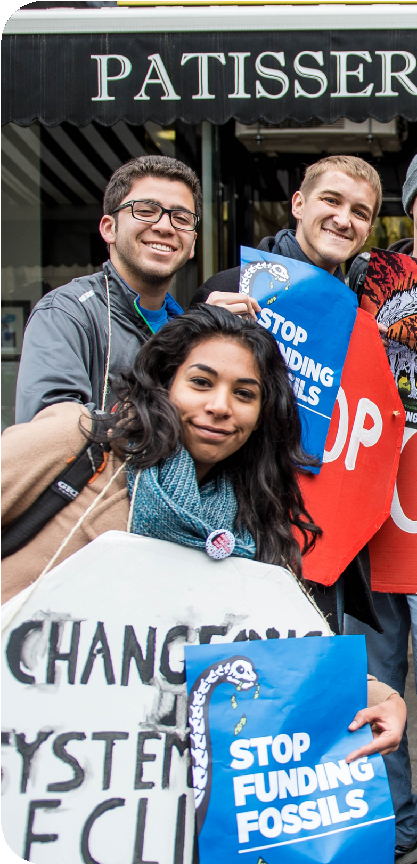

UN SDGs #12 in
Relation to SustainUs
Mary Abia Ediete | BUS6130 - Final Project

Slide 2
Overview of the Organization
02
Our Mission:
“SustainUS is a youth-led organization advancing justice and sustainability by empowering young people to engage in advocacy at the domestic and international levels” (SustainUS, 2015).
Our Vision:
“We are building toward a sustainable world free from systematic injustice.”
Who We Are:
SustainUS believes that young people should have a say in the political choices that will determine our future. In sessions on sustainable development, climate change, eradicating poverty, biodiversity loss, and women's rights at the United Nations, US youth delegations are sent by our main program, Agents of Change, to speak out for justice and sustainability. Additionally, we are creating brand-new initiatives to assist domestic organizing, such as trainings in advocacy, leadership, and young media creation.
SustainUS is a 501(c)(3) non-profit organization with legal status in the country (Devex, n.d.).
SustainUS | SDG Progress Report
Notes:
Our Mission:
“SustainUS is a youth-led organization advancing justice and sustainability by empowering young people to engage in advocacy at the domestic and international levels” (SustainUS, 2015).
Our Vision:
“We are building toward a sustainable world free from systematic injustice.”
Our Principles (SustainUS, 2015):
We are US youth demanding a world free from systematic injustice.
We intervene at global spaces of power.
We translate the demands of the people’s moment in action.
We show up as United States youth honouring indigenous treaties and seeking liberation for all people.
We build power by celebrating difference.
We are nonviolent in word and deed.
We take risks and challenge the limits of what is possible.
We show up as our full selves in community.
We are always learning and growing together.
We build toward a world where we can all thrive.
The Challenge We Face:
Systemic injustice endangers the lives of young people, including the converging problems of climate change, structural racism, rising debt, and economic stagnation.
However, young people are a vital force for change in our shared quest for international justice. To become long-term change agents who are effective, children involved in social movements in the United States might use additional support, community, and resources.
Who We Are:
SustainUS believes that young people should have a say in the political choices that will determine our future. In sessions on sustainable development, climate change, eradicating poverty, biodiversity loss, and women's rights at the United Nations, US youth delegations are sent by our main program, Agents of Change, to speak out for justice and sustainability. Additionally, we are creating brand-new initiatives to assist domestic organizing, such as trainings in advocacy, leadership, and young media creation. SustainUS is a 501(c)(3) non-profit organization with legal status in the country (Devex, n.d.).

Slide 3

4 Targets of UN SDG #12
"Sustainable consumption and production is about promoting resource and energy efficiency, sustainable infrastructure, and providing access to basic services, green and decent jobs and a better quality of life for all. Its implementation helps to achieve overall development plans, reduce future economic, environmental and social costs, strengthen economic competitiveness and reduce poverty" (SDG Tracker, 2011).
For SDG 12, the UN established 11 objectives and 13 indicators. For the sake of this presentation, I will focus on 4 of the targets.
Target 1: Mineral Footprint
The amount of material extraction necessary to provide a nation's consumption is called the "Material Footprint" (MF). The material footprints for biomass, fossil fuels, metal and non-metal ores are added up to create the overall material footprint (SDG Tracker, 2011).
Target 2: Domestic Material Consumption
A country may have a lower DMC value if it outsources a significant percentage of its resources since domestic material consumption (DMC), a production-side metric, does not take supply chain inputs or exports into account (SDG Traceker, 2011).
Target 3: Hazardous Waste Generated
The amount of hazardous waste treated by category and the amount of hazardous waste created per person (SDG Tracker, 2011).
Target 4: National Recycling Rate
The amount of municipal garbage recycled at the national level is calculated in tonnes annually (SDG Tracker, 2011).
SustainUS | SDG Progress Report
03

Slide 4
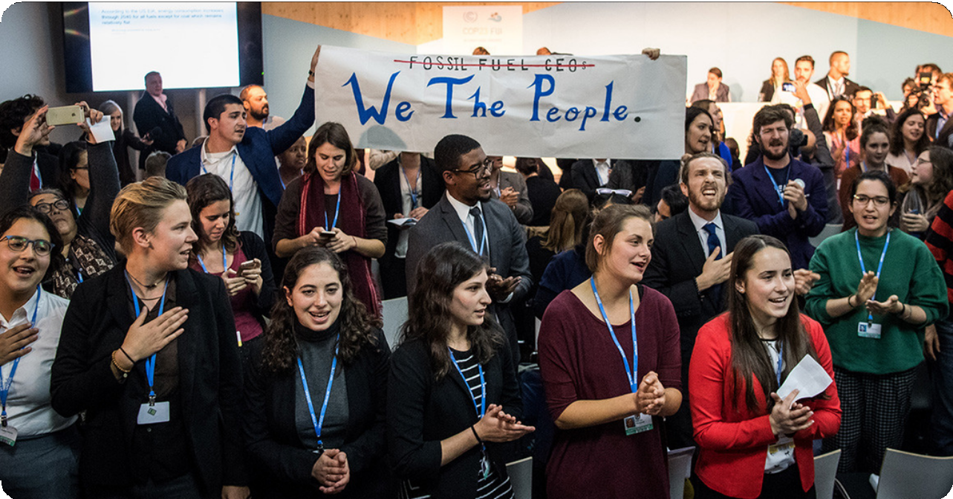
Target 1
What has been addressed by SustainUS:
We joined forces with other organizations to denounce the absence of United States from COP23, during which we opposed Donald Trump and Rex Tillerson's fossil fuel agenda (SustainUS, 2017).
At the World Bank Annual Meetings, we urged the bank to stop investing in fossil fuels after 2019 (World Bank 2018 Delegation | SustainUS, 2018).
What we hope to address:
The end of the fossil fuel era: By 2050, we want to completely phase out the use of fossil fuels, put a stop to the construction of new fossil fuel infrastructure, and ensure a fair transition to entirely renewable energy that puts workers first (SustainUS, 2017).
To impact decisions around the California Global Climate Action Summit, we have developed the next generation of frontline arts advocates.
We have also partnered with a strong global coalition of NGOs and community organizations calling for development banks to make a Big Shift away from fossil fuels (World Bank 2018 Delegation | SustainUS, 2018).
Encourage other organizations to adopt the World Bank's strategies by educating other business decision-makers on the negative effects of a high material footprint index.
SustainUS | SDG Progress Report
04
Notes:
What has been addressed:
SustainUS joined forces with other organizations in November 2017 to denounce the absence of the United States from COP23 and form a coalition that represented the genuine concerns of communities across the country that are largely opposed to the country's withdrawal from the Paris Agreement and opposed to Donald Trump and Rex Tillerson's fossil fuel agenda (SustainUS, 2017).
Eight representatives from SustainUS were dispatched to the World Bank Annual Meetings in Washington, D.C., where they asked the bank to stop investing in fossil fuels after 2019 (World Bank 2018 Delegation | SustainUS, 2018). In response to the mounting threat presented by climate change, the World Bank has declared that it would stop funding oil and gas extraction within the next two years. This decision will take effect in 2019. (World Bank to End Financial Support for Oil and Gas Extraction, 2017).
We have also partnered with a strong global coalition of NGOs and community organizations calling for development banks to make a Big Shift away from fossil fuels. By 2030, the emphasis will be on ensuring that all people have access to clean, sustainable energy (World Bank 2018 Delegation | SustainUS, 2018).
To impact decisions around the California Global Climate Action Summit, we have developed the next generation of frontline arts advocates.
What we hope to address:
The end of the fossil fuel era: By 2050, we want to completely phase out the use of fossil fuels, put a stop to the construction of new fossil fuel infrastructure, and ensure a fair transition to entirely renewable energy that puts workers first (SustainUS, 2017).
Encourage other organizations to adopt the World Bank's strategies by educating other business decision-makers on the negative effects of a high material footprint index.

Slide 5
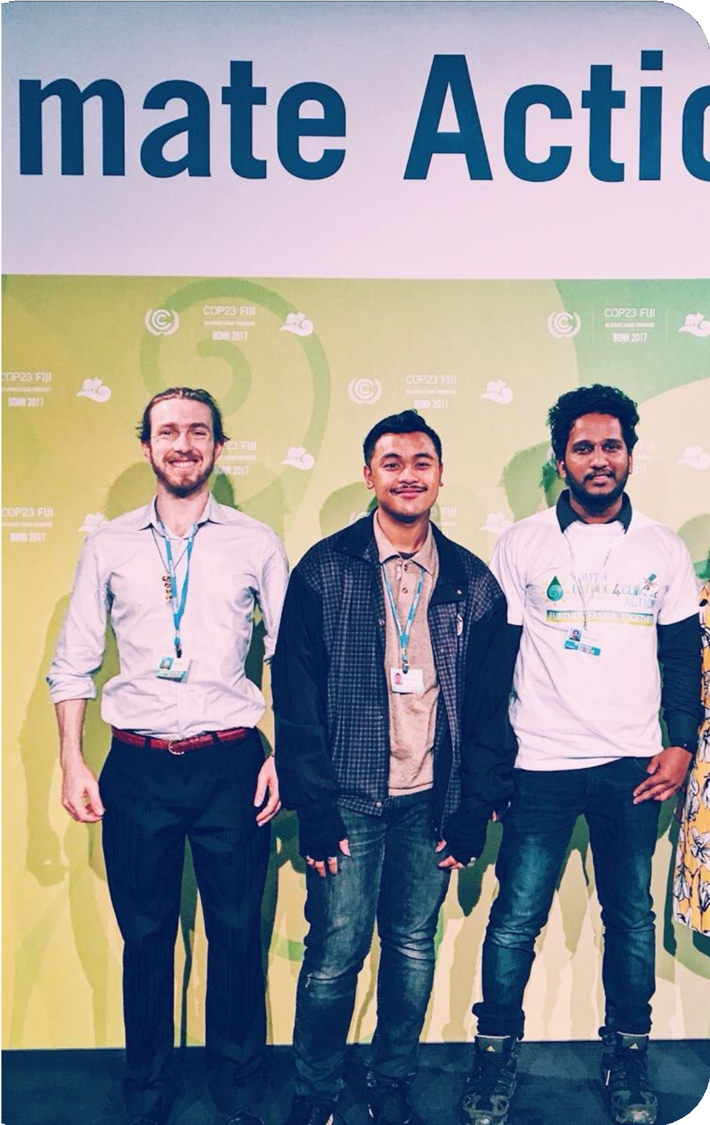
Target 2:
What has been addressed by SustainUS
We sent 15 delegates to the World Bank Meetings in October 2017, where they collaborated with other CSOs to pressure the World Bank Group to alter its stances on climate change and the equitable allocation of development financing (SustainUS, 2017).
We assigned youngsters the role of promoting strong environmental and social policies.
In order to understand why Microsoft collaborated with Chevron and Schlumberger to speed up oil extraction despite their commitment to sustainability, our delegate talked with their chief sustainability officer (SustainUS, 2022)
SustainUS | SDG Progress Report
05

Slide 6
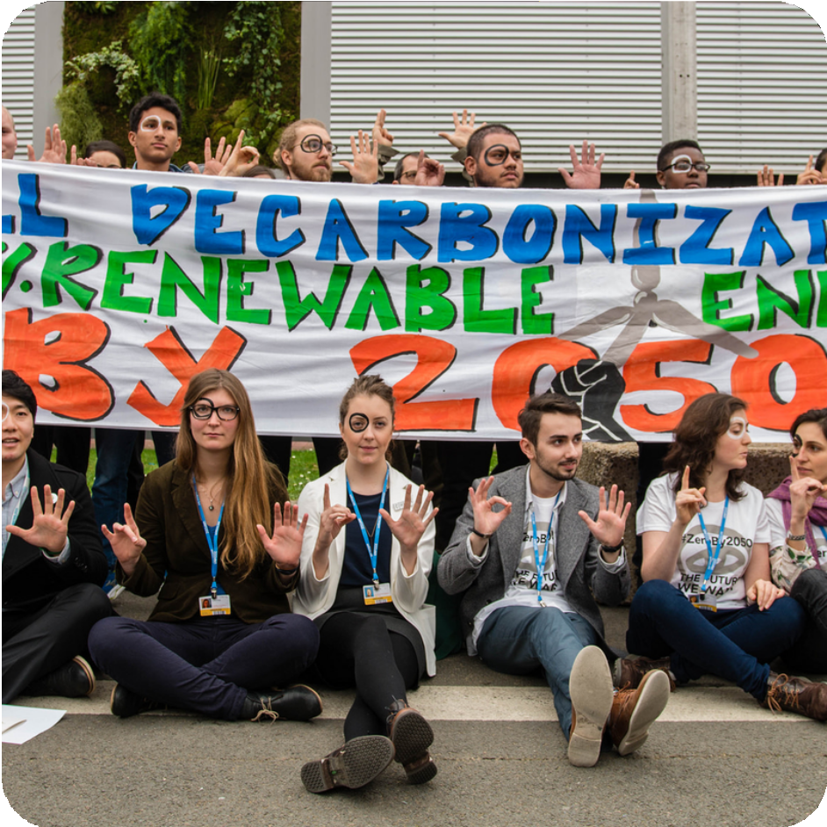
Target 3:
What has been addressed by SustainUS:
In order to demand responsibility and action plans to keep the "We Are Still In" promise, we held a town hall with local
U.S. authorities (SustainUS, 2017).
The World Bank said that it will no longer support upstream oil and gas infrastructure at our request and for other reasons.
Launched a campaign called "Kick Big Polluters Out," and as a consequence, governments representing almost 70% of mankind have refused to allow fossil fuels to sway the U.N. Climate negotiations (Freeing Climate Policy from Corporate Control CLIMATE ACTION MUST BE ROOTED in JUSTICE,
n.d.).
Raised awareness of the need for the benefits of properly recycling old electronics
What we hope to address:
Increase public knowledge of the necessity of managing hazardous waste and the risks associated with insufficient waste management.
Start a campaign to encourage the simplification of items that produce hazardous waste.
06
SustainUS | SDG Progress Report

Slide 7
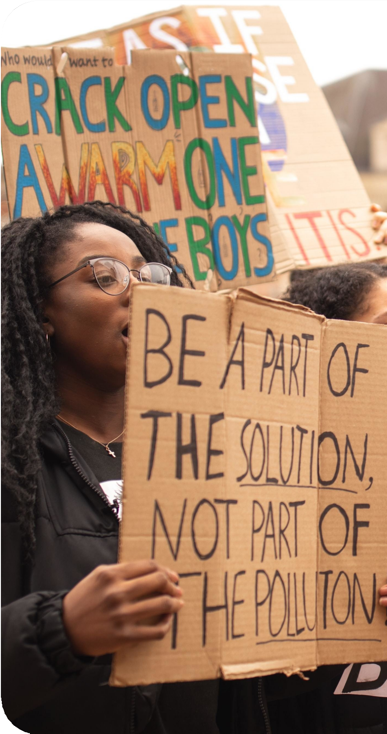
Actions That Can be Implemented to Address the 4 Targets of UN SDG #12
Start putting the 10-Year Framework of Programs on Sustainable Production and Consumption Patterns into action.
Realize efficient and sustainable management of natural resources.
Halving the amount of food wasted globally per person in retail and consumer settings, as well as cutting down on food losses throughout the supply and production chains, including post-harvest losses.
Achieving the management of all wastes and chemicals in an ecologically sound manner throughout their entire life cycle.
Lowering the production of trash by prevention, mitigation, recycling, and reuse. Encourage businesses to use sustainable methods.
Encourage sustainable public procurement procedures.
Make sure that everyone is aware of and has access to the necessary information for sustainable growth.

Slide 8
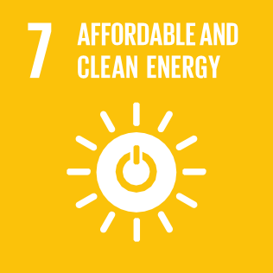
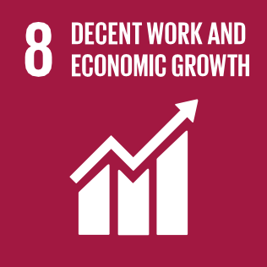

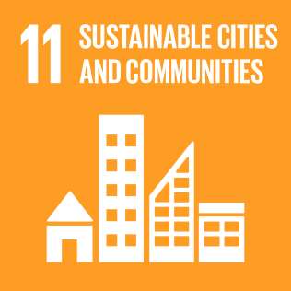
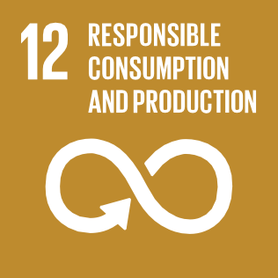


Other UN SDGs in Effect at SustainUS
SDG 10: Reduced Inequalities
SDG 11: Sustainable Cities and Communities
SDG 13: Climate Action
SDG 17: Partnerships for the Goals
SustainUS | SDG Progress Report
9
Notes:
SDG 10 – Reduced Inequalities: In order to ensure that the SDGs are completely fulfilled, SustainUS employs both genders in all elements of the organization's aims and operations.
SDG 11 – Sustainable Cities & Communities: Founded in 2003, Agents of Change (AoC) sends youth delegations from the United States to conferences and summits on global sustainability policy, particularly at the UN. With an emphasis on youth-friendly and future-oriented policies, youth delegates work together with government delegates, members of civil society, and other young people to foster collaboration.
SDG 13 – Climate Action: This is one of the strong focal points of SustainUS. And can be seen in the creation of Agents of Change has been involved in Climate change events by the UN Framework convention. To impact decisions around the California Global Climate Action Summit, we have developed the next generation of frontline arts advocates.
SDG 17 – Partnerships for the Goals: Young people are developed, inspired, and motivated to become leaders in the advancement of sustainable development through the Lead Now Fellowship, which launched in 2012. A small number of fellows are given specific mentoring, training, and tools by SustainUS to help them develop their leadership skills and use them in a sustainable development project that they are involved in.

Slide 9
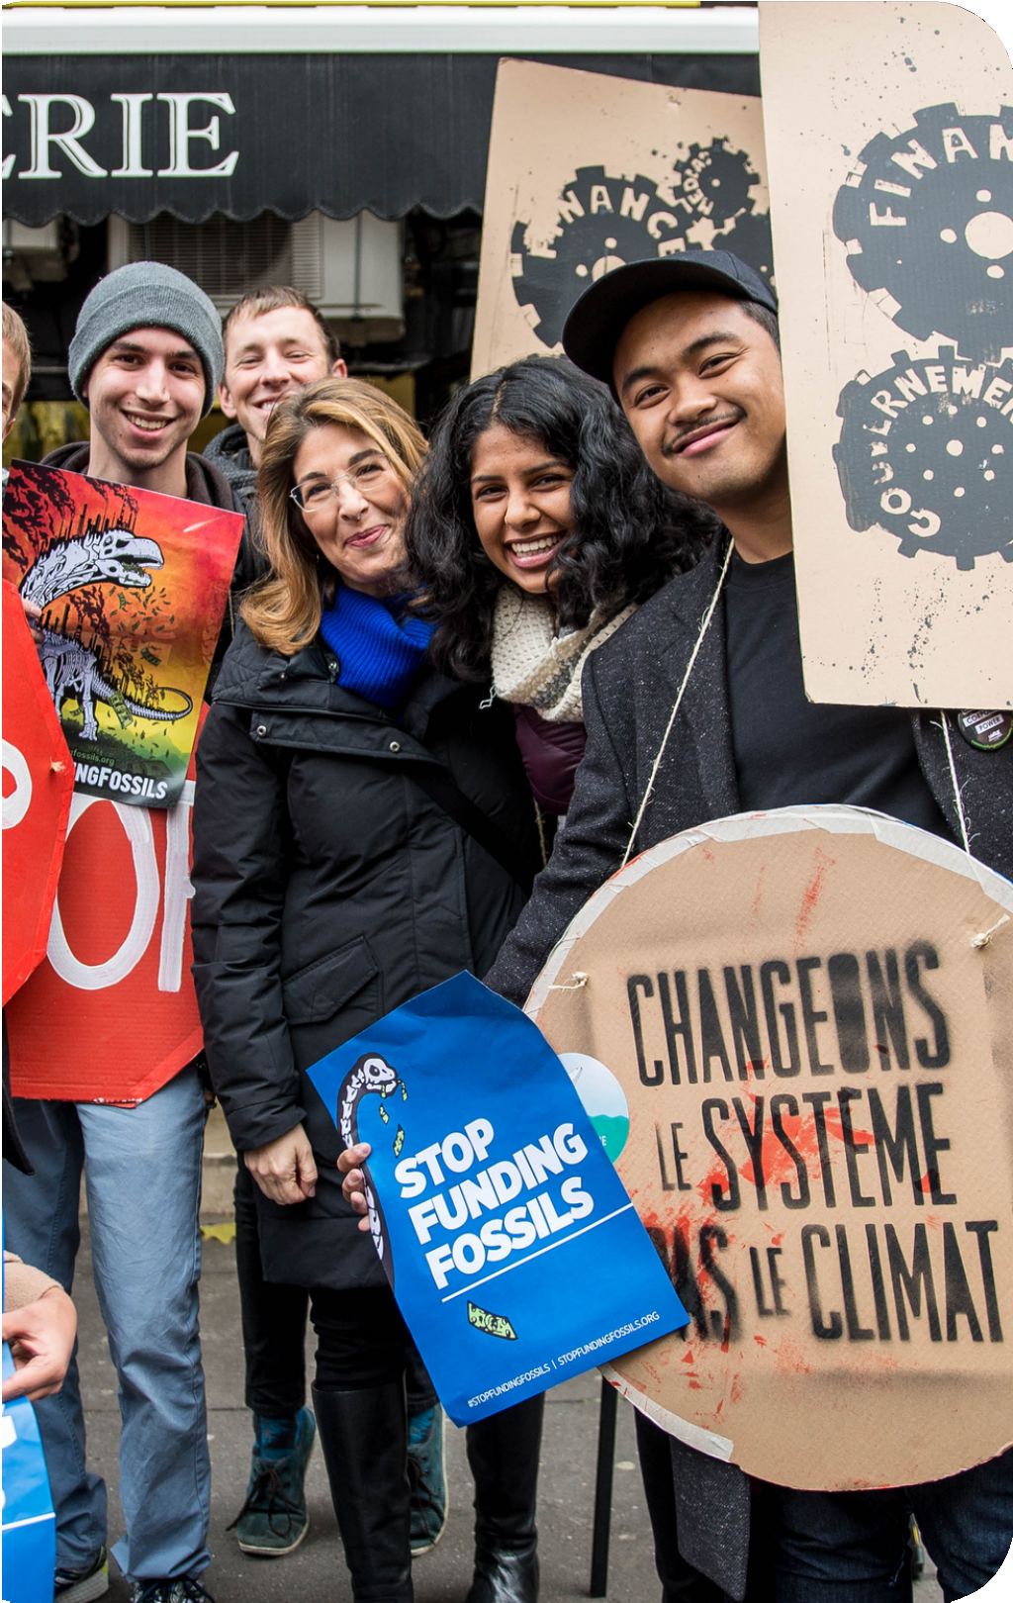
Actions to Implement Other UN SDGs
With hundreds of targets and measurement indicators focused toward the year 2030, the 17 SDGs are a collection of separate but related goals that have been meticulously planned to provide everyone on our planet a brighter future.
The objectives were developed with corporations in mind, giving them a chance to channel their influence toward particular global goals, or what some have dubbed a "Pathway for Humanity" (Vincent, 2020). SustainUS has a number of options to completely implement more UN SDGs.
Shifting the direction of public and private investment flows worldwide to address the issues the SDGs reflect.
Increasing the importance of business sustainability. Keeping up with changes in policy.
Economic and social stability.
Having a shared language and objective.
Notes:
Redirecting global public and private investment flows towards the challenges the SDGs represent. So they create new markets for companies that can deliver innovative solutions and change.
Increasing corporate sustainability value. SDGs may strengthen economic incentives for companies to use resources more efficiently or switch to more sustainable alternatives, as externalities become increasingly internalized.
Keeping up with policy changes. Companies that align their priorities with the SDGs can strengthen customer, employee, and stakeholder engagement, while those that do not face growing legal and reputational risks (SDG Compass, 2015).
Social and economic stability. No business can thrive in a failed state. Investing in the SDGs supports rule-based markets, transparent financial systems, and non-corrupt and well governed institutions.
Using a common language and goal. The SDGs define a common framework of action and language that will help companies better communicate their impact and performance to stakeholders. The goals will help synergistic partners address the worlds most pressing societal issues (SDG Compass, 2015).

Slide 10
References
Devex. (n.d.). U.S. Youth for Justice and Sustainability (SustainUS). https://www.devex.com/organizations/u-s-youth-for-justice-and-sustainability-sustainus-57031
Freeing climate policy from corporate control CLIMATE ACTION MUST BE ROOTED IN JUSTICE. (n.d.). Retrieved February 9, 2023, from https://corporateaccountability.org/wp-content/uploads/2018/03/CA_Climate_onepager_final.pdf
Huth, B. (2022, April 26). Five Actions You Can Take to Help Advance SDG 12: Responsible Consumption. Population Education. https://populationeducation.org/five- actions-you-can-take-to-help-advance-sdg-12-responsible-consumption/
SDG Compass. (2015). The guide for business action on the SDGs Developed by: TM. https://sdgcompass.org/wp- content/uploads/2015/12/019104_SDG_Compass_Guide_2015.pdf
SDG Tracker. (2011). Goal 12: Responsible Consumption and Production - SDG Tracker. Our World in Data. https://sdg-tracker.org/sustainable-consumption-production SustainUS. (2015, April 12). About | SustainUS. https://sustainus.org/about/#:~:text=SustainUS%20is%20a%20youth%2Dled
SustainUS. (2017). Training the Next Generation U.S. Youth for Justice and Sustainability. https://sustainus.org/wp- content/uploads/2019/01/SustainUS_AnnualReport_2017_R2_SinglePages_Digital-1.pdf
SustainUS. (2022). Connecting the Local to Global: Report on SustainUS’s New York City Delegation to the United Nations Secretary General’s Climate Summit Fall 2019. https://sustainus.org/wp-content/uploads/2020/02/NYCDel_FinalReport.pdf
Vincent, R. (2020, July 9). 12 Ways to Contribute to the Sustainable Development Goals (SDGs). DISCOVER the STORIES. https://blog.b1g1.com/contribute-to-sdgs/ World Bank 2018 Delegation | SustainUS. (2018, April 15). https://sustainus.org/climate/world-bank-delegations/meet-the-wb18-team/
World Bank to end financial support for oil and gas extraction. (2017, December 12). The Guardian. https://www.theguardian.com/business/2017/dec/12/uk-banks-join- multinationals-pledge-come-clean-climate-change-risks-mark-carney

